Slide 1

Geppetto
A truth layer for PMs
AI Hackathon at Blend360
Jun 2026

Slide 2
The problem Geppetto solves
In status meetings, confident statements quietly drift from reality.
A deadline that already slipped
A sign-off that never happened
A dependency still pending
TODAY
You usually catch these after the meeting — too late to correct course in the room.
WITH GEPPETTO
Geppetto moves that catch to during the meeting — so you fix it in the room.

Slide 3
How it works
1
2
3
4
5
Input Layer
Audio Pipeline
Validation Engine
Output Layer
Knowledge Layer
Live meeting audio captured from the call
Whisper transcribes speech in real time
Claude checks claims against the record
Flags drift in the room, instantly
Transcripts & status reports as ground truth
The knowledge layer compounds — every meeting sharpens the next.

Slide 4
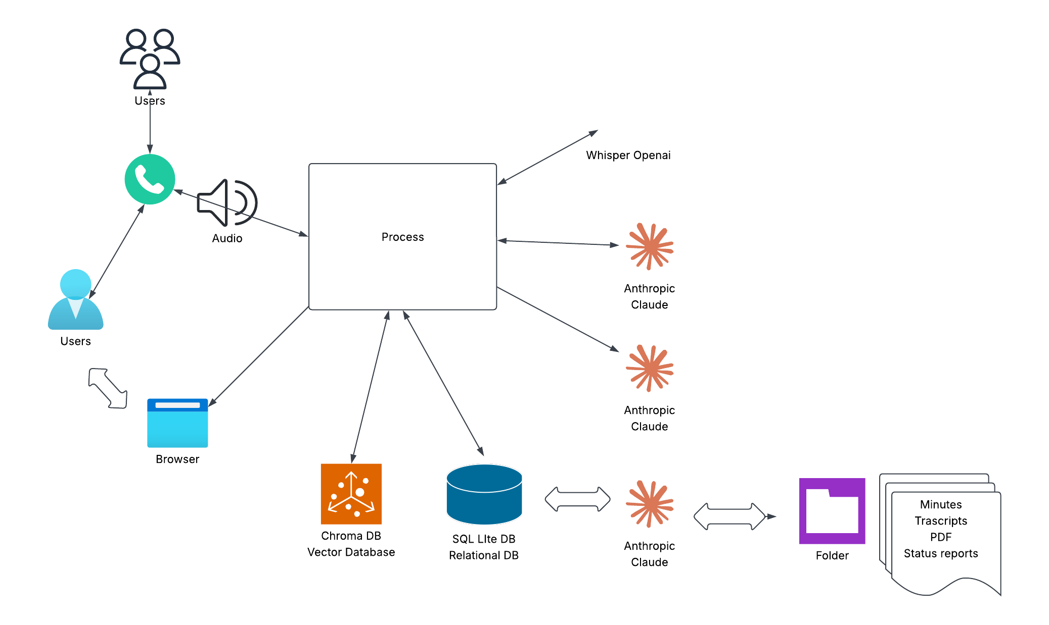

System architecture

Slide 5
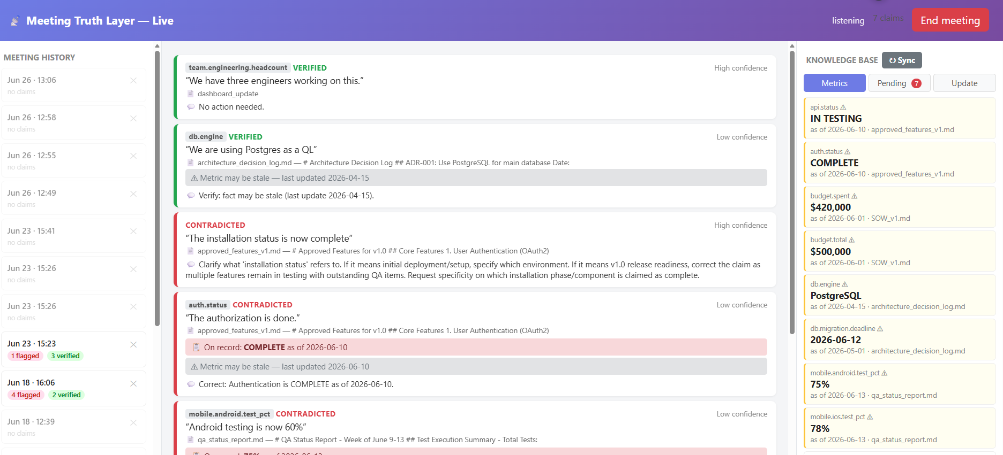
How it looks ?

Slide 6
